Slide 1
SimpleScalar
Compiled from SimpleScalar Tutorial

Slide 2
Overview
What is an architectural simulator?
  a tool that reproduces the behavior of a computing device
Why we use a simulator?
  Leverage a faster, more flexible software development cycle
    Permit more design space exploration
    Facilitates validation before H/W becomes available
    Level of abstraction is tailored by design task
    Possible to increase/improve system instrumentation
    Usually less expensive than building a real system

Slide 3
Simulators
Around 40 simulators listed at http://www.cs.wisc.edu/arch/www/tools.html
SimpleScalar (uni-processor, superscalar)
  Developed by Todd Austin while in U of Wisconsin-Madison
  Widely used in the academia and industry

Slide 4
Functional vs. Performance
Functional simulators implement the architecture.
  Perform real execution
  Implement what programmers see
Performance simulators implement the microarchitecture.
  Model system resources/internals
  Concern about time
  Do not implement what programmers see
Notes:
I mentioned in previous slide that simplescalar is highly flexible since it provide both functional and performance simulators.
Functional simulators:
Ex, for a branch predictor, you care more about the prediction accuracy than the actual timing
for example, memory and registers are visible resources to a programmer using assembly language
Performance simulators: programmers cannot see how an instruction is transmitted. However, the transmitting process is important for performance evaluation

Slide 5
Functional vs. Performance
A functional simulator runs a program just like a microprocessor supporting the same instruction set would—by taking program inputs and converting them to program outputs. However, because it does not simulate each individual processor cycle, we cannot precisely predict the speed of the processor. Functional simulators are useful when developing a new instruction set architecture as they are fast. Also, we can use functional simulators to learn about various instruction streams. For example, we may like to find out how often branch instructions occur, or how often dependencies exist between instructions. In addition to being a useful tool for computer architects, the speed of functional simulators allows compiler writers and application developers to test their work without actually first building a microprocessor.
A performance (or timing) simulator measures the performance of a microprocessor design by keeping track of individual clock cycles. Thus we can use performance simulation to find instructions per cycle (IPC), or its inverse (CPI). The drawback of maintaining such detailed timing information is much slower execution time compared to a functional simulator. In the SimpleScalar suite, the fastest functional simulator can simulate instructions 25 times faster than the performance simulator.
We usually prefer to use a functional simulator to make a measurement or perform an experiment. Sometimes, we can use a clever method or accept some inaccuracy in our measurements to avoid the use of a performance simulator while still making useful measurements.
We try to leave the performance simulator as a last resort, since simulation time is long. Of course, in some cases, we have no choice but to use a performance simulator. Choosing between a functional and performance simulator and instrumenting them to extract results is part of the art of architectural simulation and design.

Slide 6
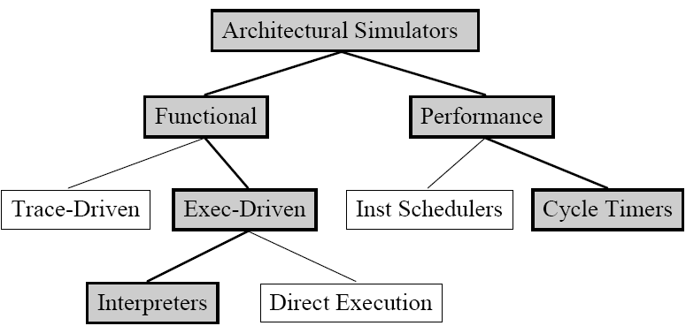
A Taxonomy of Simulation Tools
Shaded tools are included in SimpleScalar Tool Set
Notes:
Before I introduce the detail of simplescalar, I first give you some general knowledge about simulators. This graph here shows a classification of simulators.

Slide 7
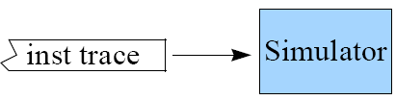
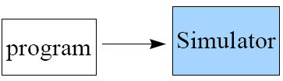
Trace- vs. Execution-Driven
Trace-Driven
  Simulator reads a ‘trace’ of the instructions captured during a previous execution
  Easy to implement, no functional components necessary
Execution-Driven
  Simulator runs the program (trace-on-the-fly)
  Hard to implement
  Advantages
    Faster than tracing
    No need to store traces
    Register and memory values usually are not in trace
    Support mis-speculation cost modeling
Notes:
One thing I want to point out is that a simulator can both be an execution driven and a performance simulator.

Slide 8
Instruction Schedulers vs. Cycle Timers
Instruction Schedulers
  Simulator schedules instruction when resources are available
  Instructions proceeded one at a time
  Simpler, but less detailed
Cycle Timers
  Simulator tracks microarchitecture state each cycle
  Simulator state == microarchitecture state
  Perfect for microarchitecture simulation

Slide 9
SimpleScalar Release 3.0
SimpleScalar now executes multiple instruction sets: SimpleScalar PISA (the old "SimpleScalar ISA") and Alpha AXP.
All simulators now support external I/O traces (EIO traces). Generated with a new simulator (sim-eio)
Support more platforms
explicit fault support
And many more
Notes:
Alpha AXP: Anomalous X-ray Pulsar, a MIPS (Microprocessor without interlocked pipeline stages ) ISA

Slide 10
Advantages of SimpleScalar
Highly flexible
  functional simulator + performance simulator
Portable
  Host: virtual target runs on most Unix-like systems
  Target: simulators can support multiple ISAs
Extensible
  Source is included for compiler, libraries, simulators
  Easy to write simulators
Performance
  Runs codes approaching ‘real’ sizes

Slide 11
Simulator Suite
Sim-Fast
Sim-Safe
Sim-Profile
Sim-Cache
Sim-BPred
Sim-Outorder
300 lines
functional
No timing
350 lines
functional w/checks
900 lines
functional
Lot of stats
< 1000 lines
functional
Cache stats
Branch stats
3900 lines
performance
OoO issue
Branch pred.
Mis-spec.
ALUs
Cache
TLB
200+ KIPS
Performance
Detail

Slide 12
Sim-Fast
Functional simulation
Optimized for speed
Assumes no cache
Assumes no instruction checking
Does not support Dlite (source level target program debugger, .h, .c )!
Does not allow command line arguments
<300 lines of code

Slide 13
Sim-Safe
Functional simulation
Checks for instruction errors
Optimized for speed
Assumes no cache
Supports Dlite!
Does not allow command line arguments
26年 11月 7日

Slide 14
Sim-Cache
Cache simulation
Ideal for fast simulation of caches (if the effect of cache performance on execution time is not necessary)
Accepts command line arguments for:
  level 1 & 2 instruction and data caches
  TLB configuration (data and instruction)
  Flush and compress
  and more
Ideal for performing high-level cache studies that don’t take access time of the caches into account

Slide 15
Sim-Bpred
Simulate different branch prediction mechanisms
Generate prediction hit and miss rate reports
Does not simulate the effect of branch prediction on total execution time
  nottaken
  taken
  perfect
  bimod bimodal predictor
  2lev 2-level adaptive predictor
  comb combined predictor (bimodal and 2-level)

Slide 16
Sim-Profile
Program Profiler
Generates detailed profiles, by symbol and by address
Keeps track of and reports
Dynamic instruction counts
  Instruction class counts
  Branch class counts
  Usage of address modes
  Profiles of the text & data segment

Slide 17
Sim-Outorder
Most complicated and detailed simulator
Supports out-of-order issue and execution
Provides reports
  branch prediction
  cache
  external memory
  various configuration

Slide 18
Sim-Outorder HW Architecture
Fetch
Dispatch
Register
Scheduler
Exe
Writeback
Commit
Memory
Scheduler
Mem
I-Cache
I-TLB
D-Cache
D-TLB
Virtual Memory

Slide 19
RUU/LSQ in Sim-Outorder
RUU (Register Update Unit)
  Handles register synchronization/communication
  Serves as reorder buffer and reservation stations
  Performs out-of-order issue when register and memory dependences are satisfied
LSQ (Load/Store Queue)
  Handles memory synchronization/communication
  Contains all loads and stores in program order
Relationship between RUU and LSQ
  Memory dependencies are resolved by LSQ
  Load/Store effective address calculated in RUU

Slide 20
Sim-Outorder parameters
Instruction fetch queue size, decode and issue bandwidth
Capacity of RUU and LSQ
Branch mis-prediction latency
Number of functional units
  integer ALU, integer multipliers/dividers
  FP ALU, FP multipliers/dividers
Latency of I-cache/D-cache, memory and TLB
Record statistic by text address
Guess what your HW3 will be : )

Slide 21
Global Options
These are supported on most simulators
  -h print help message
  -d enable debug message
  -i start up in Dlite! Debugger
  -q quit immediately (use with -dumpconfig)
  -config read config parameters from <file>
  -dumpconfig save config parameters into <file>

Slide 22
Sim-Outorder: Fetch
ruu_fetch()
Models machine fetch stage
Fetches instructions from one I-cache/memory
  block until I-cache misses are resolved
Instructions are put into the instruction fetch queue named fetch_data (or IFQ) in sim-outorder.c (it is also called dispatch queue in the paper)
Probes branch predictor to obtain the cache line for next cycle

Slide 23
Sim-Outorder: Dispatch
ruu_dispatch()
Models instruction decoding and register renaming
Takes instructions from fetch_data (or IFQ)
Decodes instructions
Enters and links instructions into RUU and LSQ
Splits memory operations into two separate instructions

Slide 24
Sim-Outorder: Scheduler
ruu_issue() and lsq_refresh()
Models instruction selection, wakeup and issue
For register dependency: ruu_issue()
  Locates instructions with all register inputs ready
For memory dependency: lsq_refresh()
  Locates instructions with all memory inputs ready
  Issue of ready loads is stalled if there is a store with unresolved effective address in LSQ.
  If earlier store address matches load address, target value is forwarded to load.

Slide 25
Sim-Outorder: Execute
ruu_issue()
Models functional units, D-cache issue and executes latencies
Gets instructions that are ready
Reserves free functional unit
Schedules writeback events using latency of the functional unit
Latencies are hardcoded in fu_config[] in sim-outorder.c

Slide 26
Sim-Outorder: Writeback
ruu_writeback()
Models writeback bandwidth, detects mis-predictions, initiated mis-prediction recovery sequence
Gets execution finished instructions (specified in event queue)
Wakes up instructions that are dependent on completed instruction on the dependence chains of instruction output
Detects branch mis-prediction and roll state back to checkpoint

Slide 27
Sim-Outorder: Commit
ruu_commit()
Models in-order retirement of instructions, store commits to the D-cache, and D-TLB miss handling
While head of RUU/LSQ ready to commit
  D-TLB miss handling
  Retire store to D-cache
  Update register file and rename table
  Reclaim RUU/LSQ resources

Slide 28
Sim-Outorder (Main Loop)
sim_main() in sim-outorder.c
      ruu_init();
      for(;;){
      ruu_commit();
      ruu_writeback();
      lsq_refresh();
      ruu_issue();
      ruu_dispatch();
      ruu_fetch();
      }
Executed once for each simulated machine cycle
Walks pipeline from Commit to Fetch
  Reverse traversal handles inter-stage latch synchronization by only one pass

Slide 29
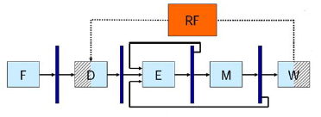
Forwarding in Simplescalar
The processor that SimpleScalar simulates implements forwarding. It means that the result of an instruction can be obtained from another instruction before being written into the register file.

Slide 30
Viewing the Execution trace in pipeline
Ptrace is used to show the order of execution of the program
-ptrace <filename>.trc 0:1024 (this command is included in the configuration file) allows to record all the details of instructions execution in the pipeline. These data are stored in a <filename>.trc file which is located in the /simplescalar3.0/ directory and which can be visualized with pipeview.pl (Perl script).
The Trace file can be visualized as
./pipeview.pl filename.trc | less

Slide 31
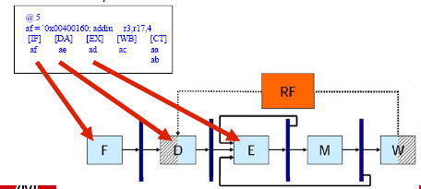
Reading the result of the trace
Each line indicates the state of the processor at the end of a cycle.

Slide 32
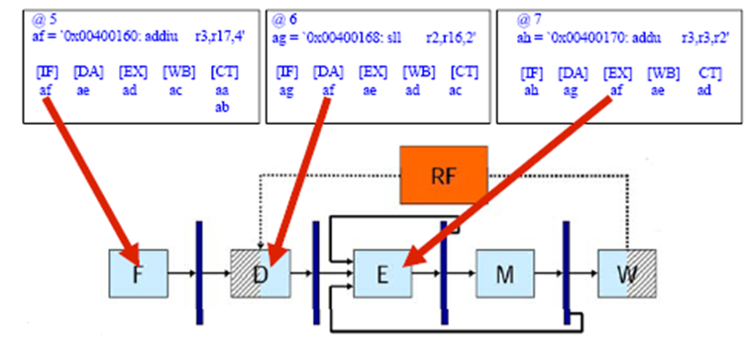
Following a simple instruction

Slide 33
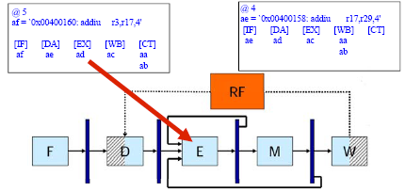
Forwarding in simplescalar: example

Slide 34
Specifying Sim-outorder
  -fetch:ifqsize <size> -instruction fetch queue size (in insts)
  -fetch:mplat <cycles> - extra branch miss-prediction latency (cycles)
  …
  -bpred <type>
  -bpred:bimod <size>
  -bpred:2lev <l1size> <l2size> <hist_size>
  …
  -config <file>
  -dumpconfig <file>
$ sim-outorder –config <file> <benchmark command line>

Slide 35
Benchmark
SPEC CPU 2000
  Integer/Floating Point
  http://www.spec.org
  For homework: Alpha binaries, input data files
input
ref
179.art
data
output
CFP2000
…
src
test
164.gzip
…
train
CINT2000
…
Directory organization

Slide 36
Useful Links
  http://www.simplescalar.com/
  Running SPEC2000 Benchmarks with SimpleScalar
    http://arch.cs.duke.edu/spec2000.html
  Running spec2000 (int, fp) with SimpleScalar (commandlines)
    http://kbarr.net/specfp2000-commandlines
    http://kbarr.net/specint2000-commandlines.html

Slide 37
SimpleScalar Components
simplesim-3v0d.tgz: SimpleScalar simulator source code;
simpletools-2v0.tgz: gcc compiler and glibc;
simpleutils-2v0.tgz: binary utilities;

Slide 38
Directories after untarring ALL
simplesim-3.0/: the sources of the SimpleScalar simulators.
binutils-2.5.2/: the GNU binary utilities code, ported to the SimpleScalar architecture.
sslittle-na-sstrix/: the root directory for the tree in which little-endian SimpleScalar binary utilities and compiler tools will be installed. The unpacked directories contain header files and a pre-compiled copy of libc.
ssbig-na-sstrix/: the same as above, except that it holds big-endian stuff.
gcc-2.6.3/: the GNU C compiler code, ported to SimpleScalar architecture.
glibc-1.09/: the GNU libraries code, ported to SimpleScalar architecture.

Slide 39
Installing simplesim
Download simplesim‐3v0d.tgz from http://www.simplescalar.com/.
Logon the Linux machine “shell.ece.arizona.edu”
Create an empty directory in you home directory, say, “$HOME/simplescalar/”
Copy the tar file to that directory.
cd $HOME/simplescalar/
Untar the downloaded file.
  $ gunzip simplesim-3v0d.tgz
  $ tar -xvf simplesim-3v0d.tar
Read the README file under simplesim3.0 directory.
Compile the simulator
  $ make config-alpha (other option is “make config-pisa”)
  $ make
The simulator is now ready for use

Slide 40
Installing simpletools and simpleutils
Refer to the installation guide
You will gain valuable experience in this procedure.
These tools essential when you want to compile your own code!!

Slide 41
Check your installation
Check $HOME/simplescalar/bin for the complier, assembler, linker, and other binary utilities.
  Write simple program to verify it
Check $HOME/simplescalar/simplesim-3.0 for simulators
  cd $HOME/simplescalar/simplesim-3.0
  make sim-tests

Slide 42
How to use it
Write program
  Write C code.
  Or, just write assembly code
Compile the source code
  sslittle-na-sstrix-gcc –o foo foo.c C code to binary code
  sslittle-na-sstrix-gcc –o foo.s –S foo.c C code to Assemble code
  sslittle-na-sstrix-gcc –o foo foo.s Assemble code to binary code
Use the simulator to run the binary code
  sim-fast foo
OR
  Use the existing binaries in the test folder

Slide 43
Configuration files
The architecture of the system is defined by the configuration files
Example configuration files are in simplesim-3.0\config
Chapter 4.4 of the user document («Out-of-order processor timing simulation») gives an explanation about the architecture of the processor and describes the configuration parameters.

Slide 44
test_math benchmark
There are few default benchmarks that come with the simplescalar simulator
simplesim-3.0/tests-alpha/ contains small benchmarks.
tests-alpha/src/ contains the sources of the benchmarks.
test-math does not need input and generates a list of arithmetic operations as output. This program calls both integer and floating-point instructions.

Slide 45
Sample runs
./sim-safe
./sim-safe ./tests-alpha/bin/test-math
More elaborate run
  mkdir results
  ./sim-safe –redir:sim ./results/sim1.out –redir:prog ./results/prog1.out ./tests-alpha/bin/test-math
  In sim1.out note sim_num_insn (total number of instructions executed) and sim_num_refs (number of loads and stores).
Exercise: Rerun sim-safe on test-math, but this time, also set the –max:inst option to 50000 instructions. Redirect simulator output to results/sim2.out and program output to results/prog2.out.

Slide 46
What is next
Profiling, branch prediction, pipeline and cache simulations followed by evaluating design tradeoffs
Designing your own branch prediction algorithm,
Designing cache replacement policy

